Slide 1
進捗報告
PARK TAEJOON
2020-02-03

Slide 2

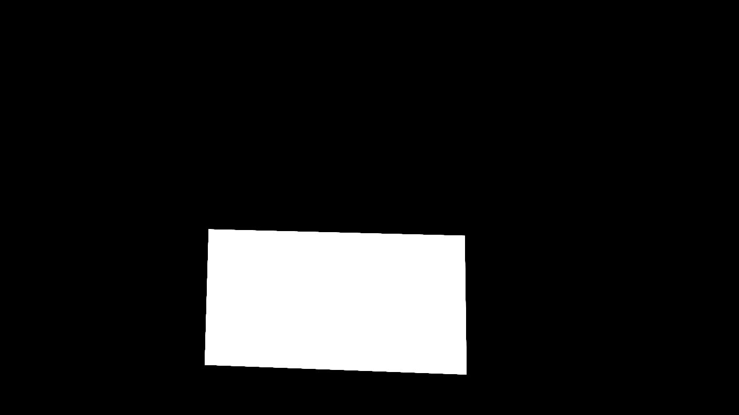
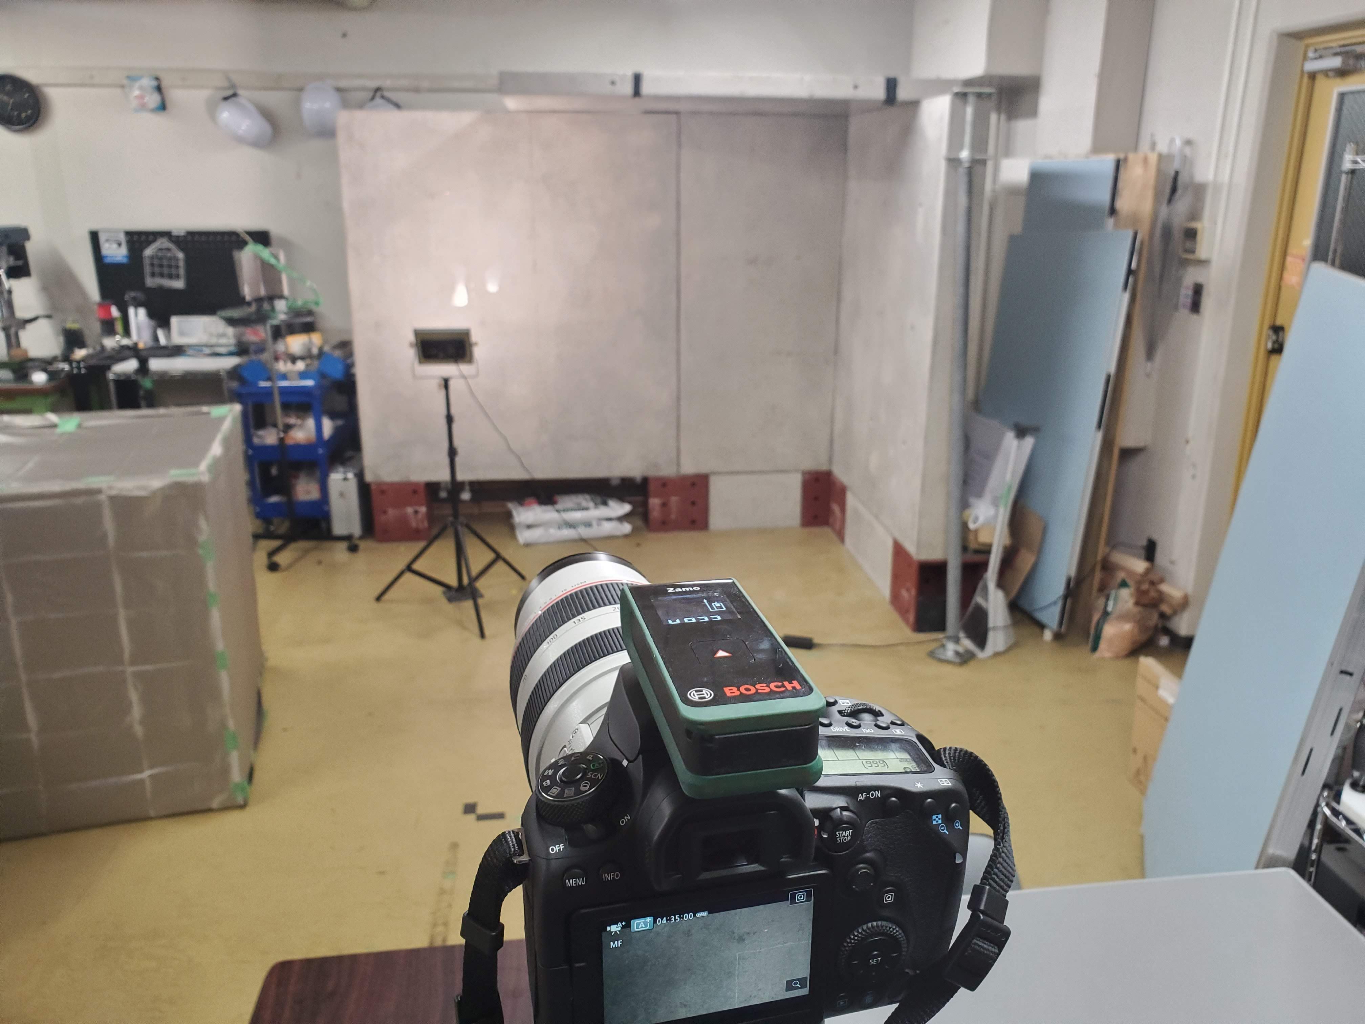
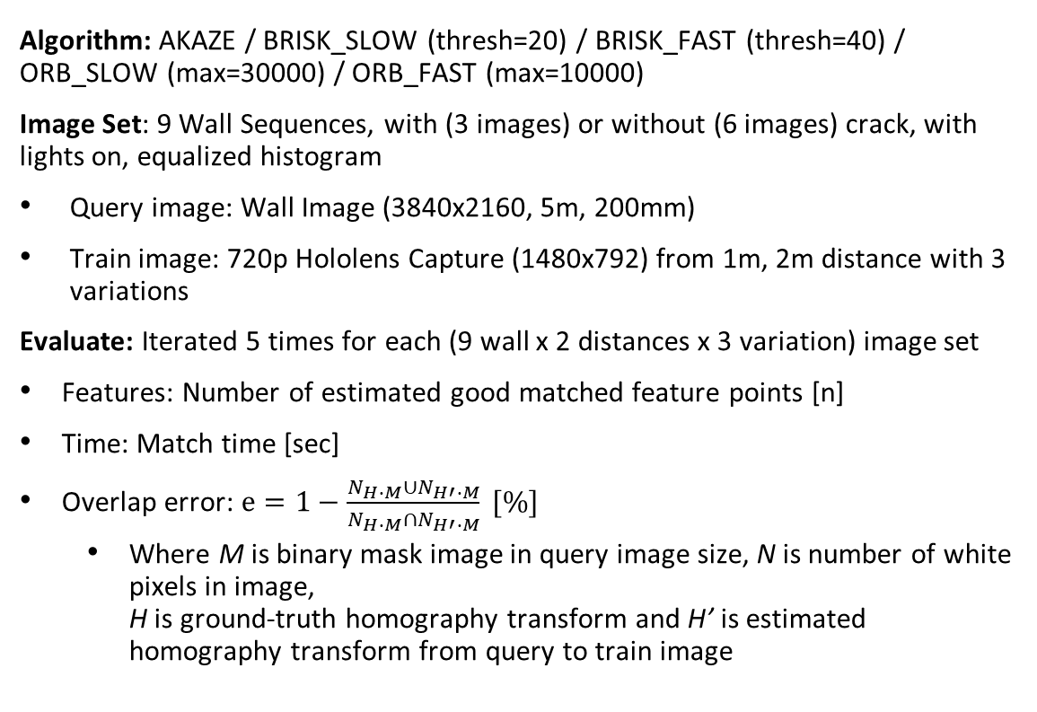
Feature Match Experiment
Algorithm: AKAZE / BRISK_SLOW (thresh=20) / BRISK_FAST (thresh=40) / ORB_SLOW (max=30000) / ORB_FAST (max=10000)
Image Set: 9 Wall Sequences, with (3 images) or without (6 images) crack, with lights on, equalized histogram
Query image: Wall Image (3840x2160, 5m, 200mm)
Train image: 720p Hololens Capture (1480x792) from 1m, 2m distance with 3 variations
Evaluate: Iterated 5 times for each (9 wall x 2 distances x 3 variation) image set
Features: Number of estimated good matched feature points [n]
Time: Match time [sec]
Overlap error: $e=1−\frac{N_{H∙M}∪N_{H′∙M}}{N_{H∙M}∩N_{H′∙M}} [\%]$
Where M is binary mask image in query image size, N is number of white pixels in image, H is ground-truth homography transform and H’ is estimated homography transform from query to train image

Slide 3
Feature Match Experiment Results

Slide 4
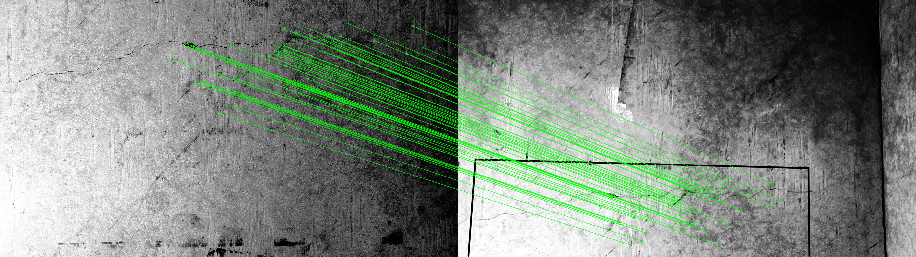
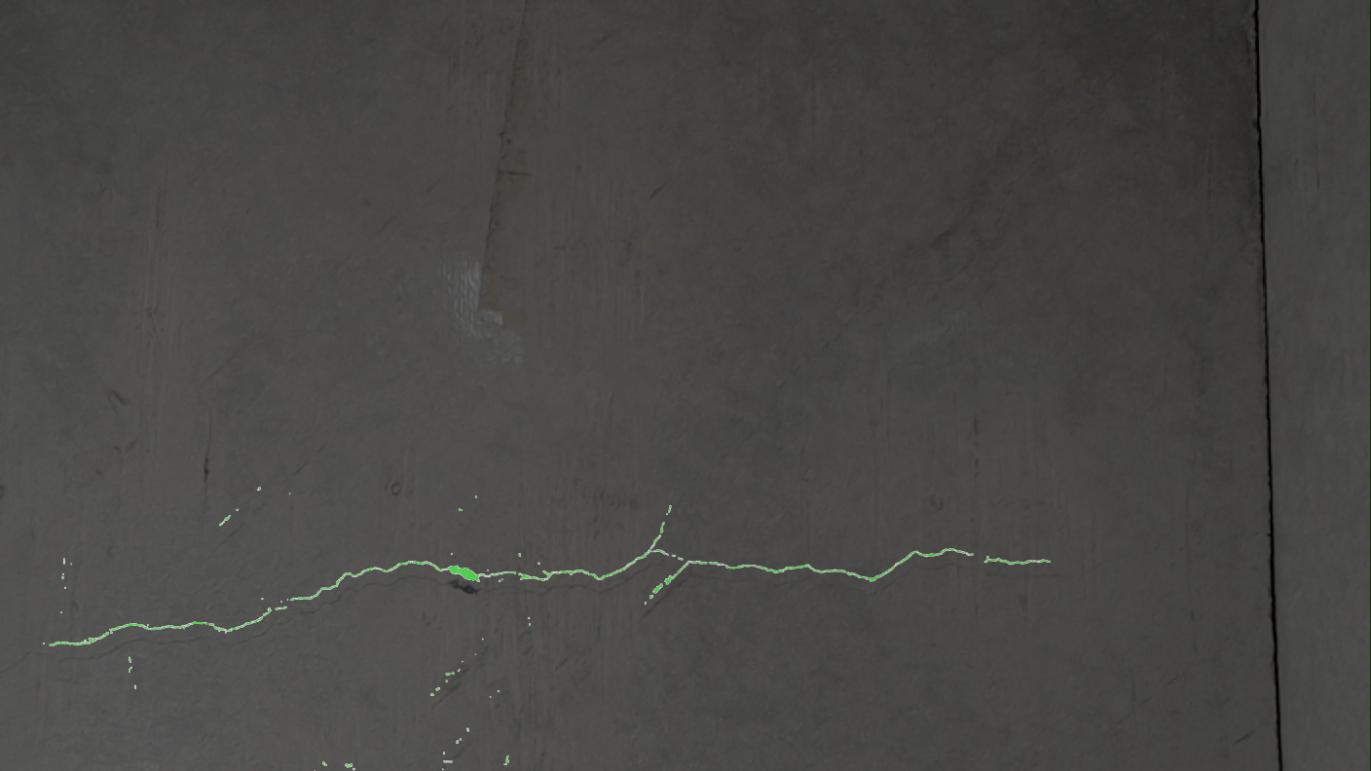
Feature Match Experiment Results
Success rate: BRISK_SLOW = ORB_FAST >= ORB_SLOW > AKAZE >> BRISK_FAST
Accuracy (Success only): ORB_SLOW > AKAZE = BRISK_FAST = BRISK_SLOW > ORB_FAST
Computing efficiency: AKAZE >= BRISK_FAST >= ORB_FAST >> ORB_SLOW >> BRISK_SLOW
Max features (Success only): ORB_SLOW > BRISK_SLOW > ORB_FAST >> AKAZE >= BRISK_FAST

Slide 5
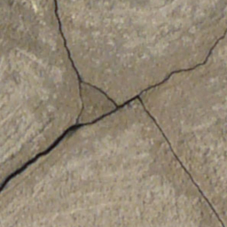
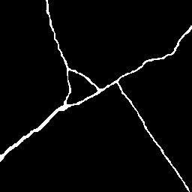
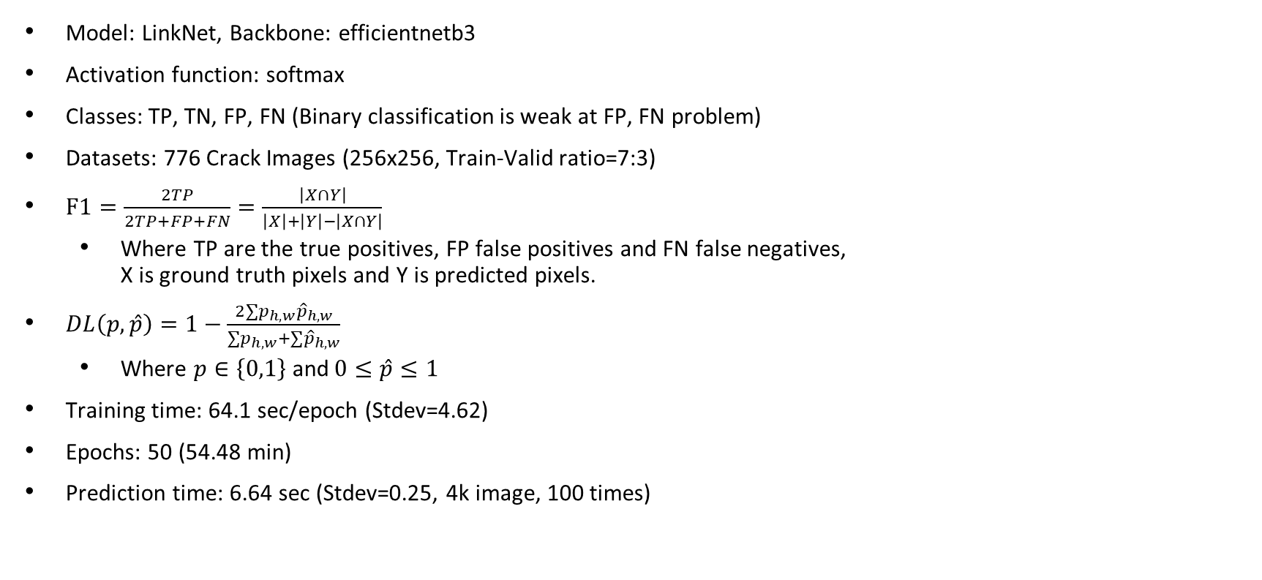
Encoder-Decoder Based Network
Model: LinkNet, Backbone: efficientnetb3
Activation function: softmax
Classes: TP, TN, FP, FN (Binary classification is weak at FP, FN problem)
Datasets: 776 Crack Images (256x256, Train-Valid ratio=7:3)
$F1=\frac{2TP}{2TP+FP+FN}=\frac{\left|X∩Y\right|}{\left|X\right|+\left|Y\right|−\left|X∩Y\right|}$
Where TP are the true positives, FP false positives and FN false negatives, X is ground truth pixels and Y is predicted pixels.
$DL\left(p,\hat{p}\right)=1−\frac{2∑p_{h,w}{\hat{p}}_{h,w}}{∑p_{h,w}+∑{\hat{p}}_{h,w}}$
Where $p∈\left\{0,1\right\}$ and$0≤\hat{p}≤1$
Training time: 64.1 sec/epoch (Stdev=4.62)
Epochs: 50 (54.48 min)
Prediction time: 6.64 sec (Stdev=0.25, 4k image, 100 times)

Slide 6
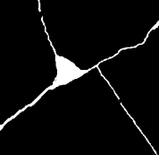
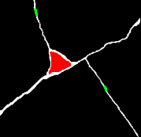
Ground-truth creation from prediction
Ground-truth creation from predicted crack
TP: Marked as white pixels, used for re-training data
TN: Marked as black pixels, used for re-training data
FP: Marked as green pixels, predict again with noise-sensitive model to mark cracks properly
FN: Marked as red pixels, used for re-training data
Dataset: 120 Crack Images (256x256, Train-Valid-Test ratio=9:1)
Training time: 25.2 sec/epoch (Stdev=13.86), Epochs: 10 (2.1 min)
TN
FN
FP
TP
Input image
Binary Ground truth
Prediction
4-Class Ground truth
4-Class Prediction
Final Prediction

Slide 7

Wall

Slide 8
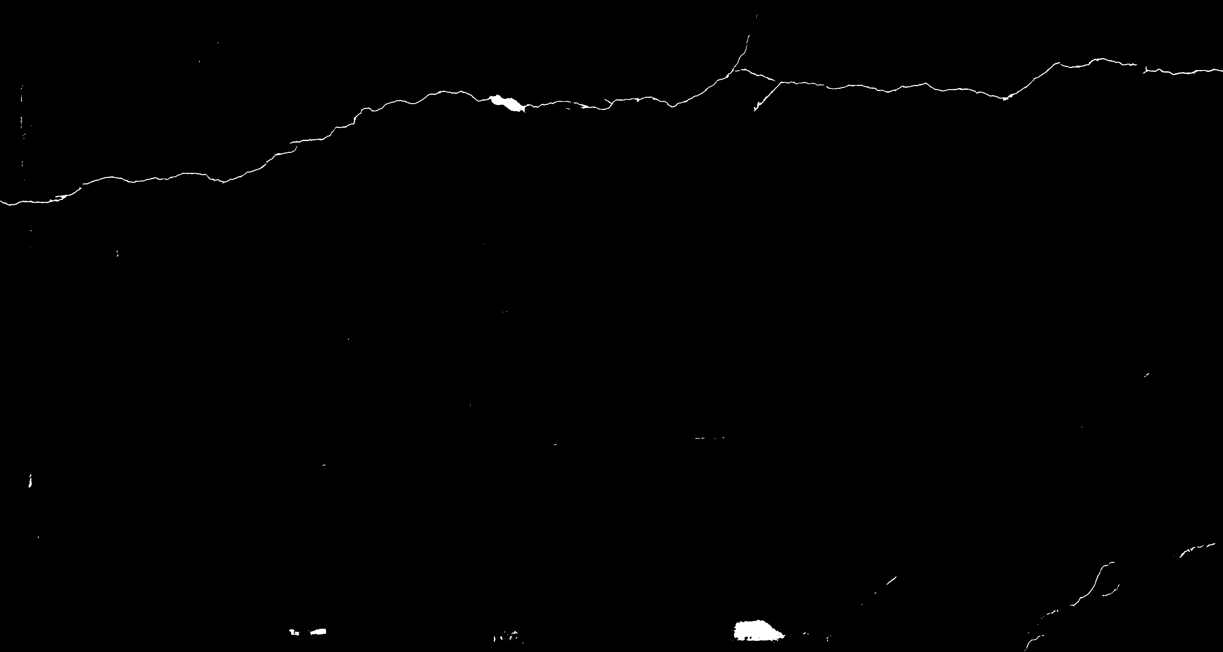
Predicted [Initial weight]

Slide 9
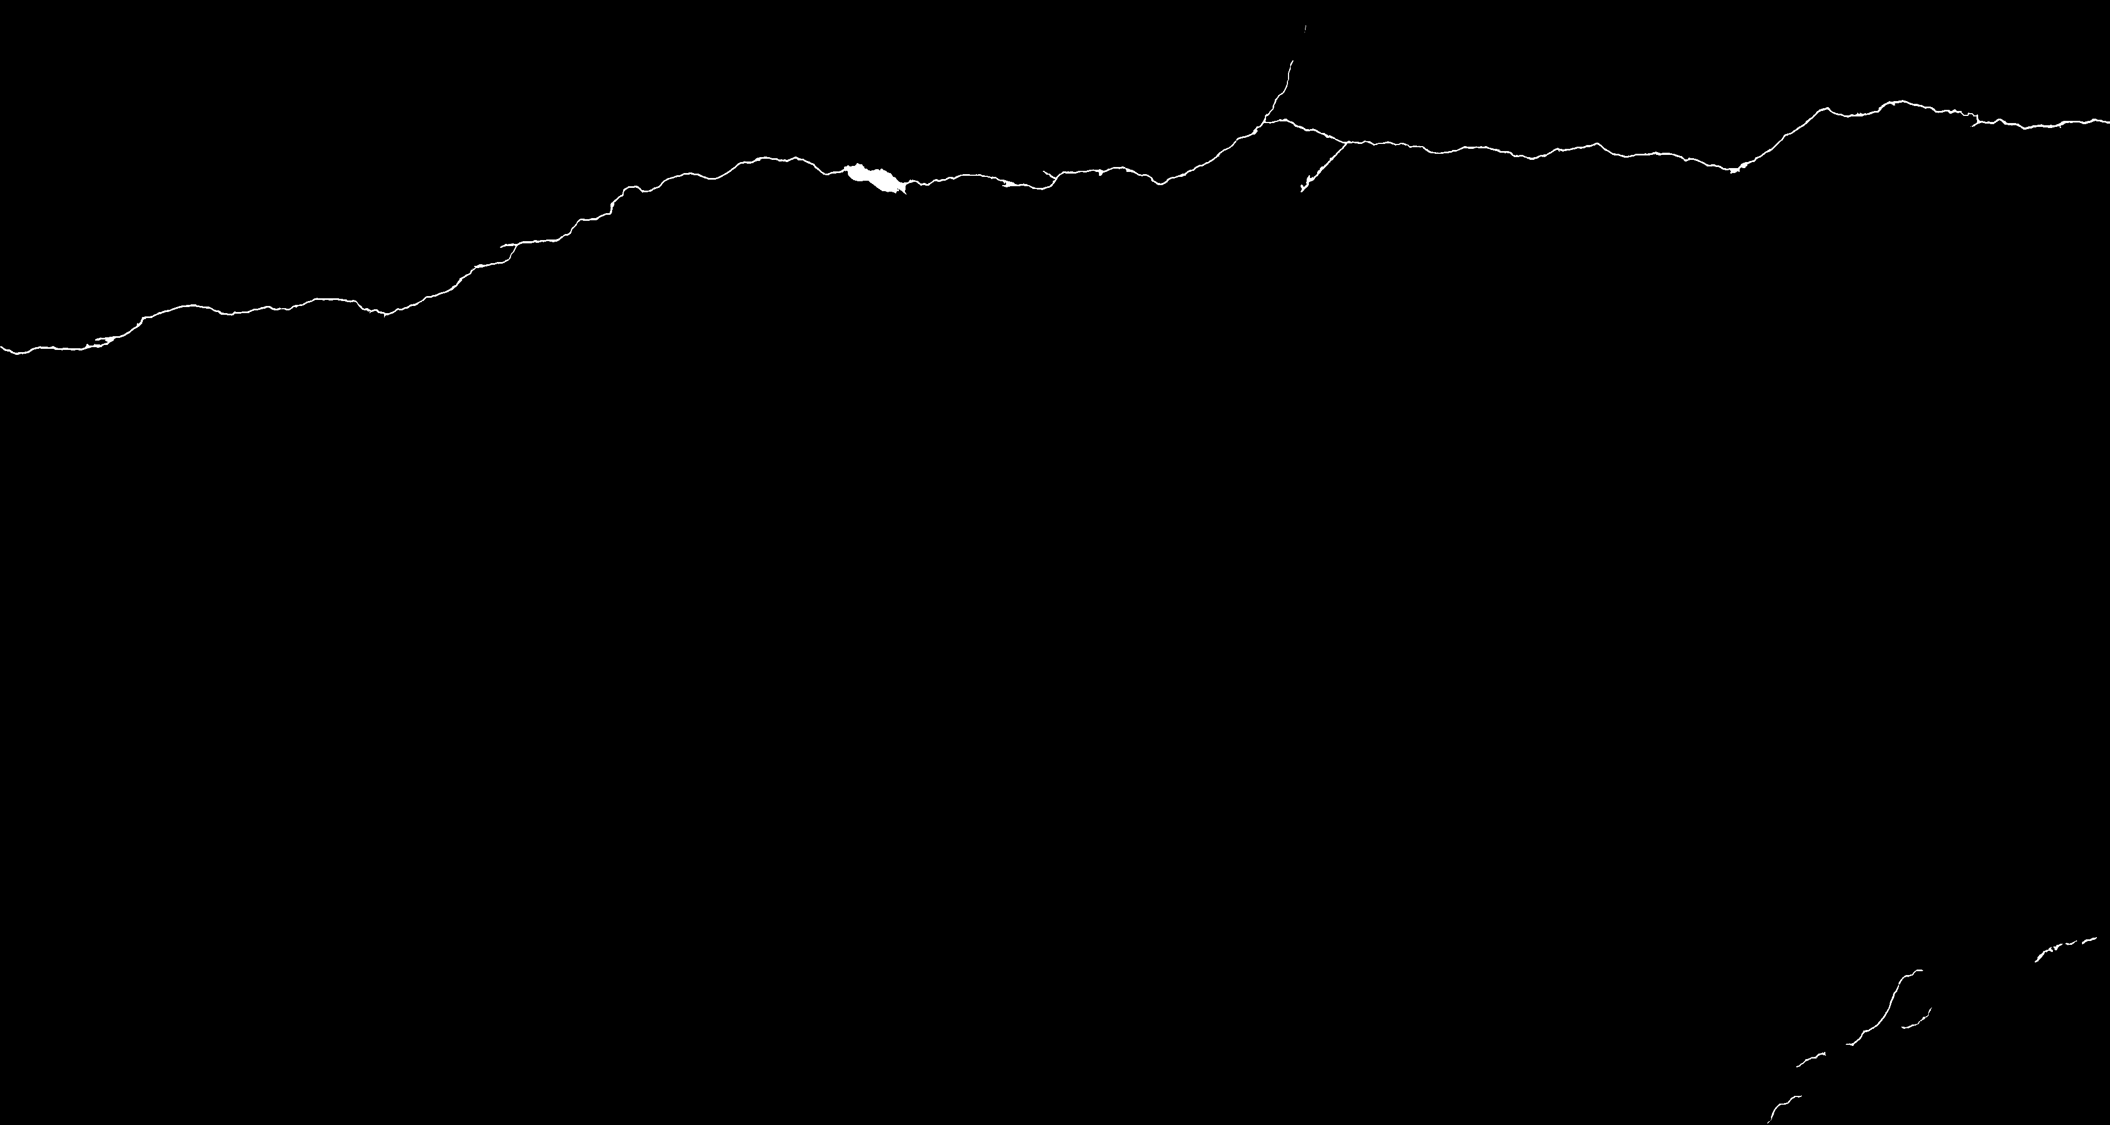
Ground truth [New weight A]

Slide 10
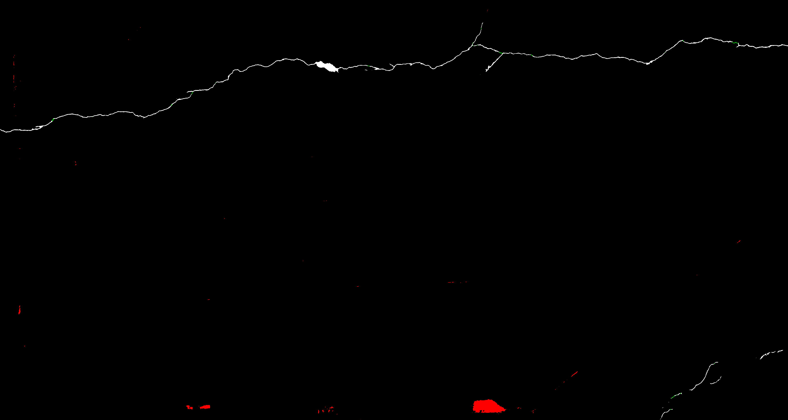
Ground truth [New weight B]

Slide 11

Predicted [New weight A]

Slide 12
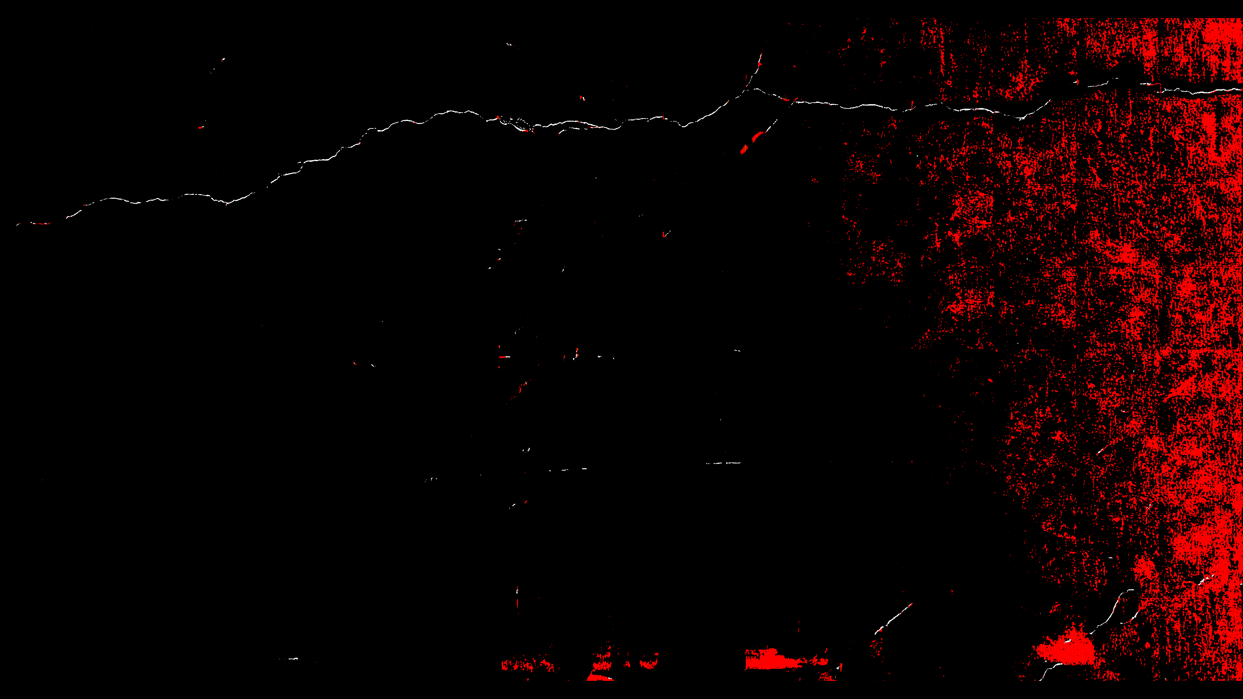
Predicted [New weight B]

Slide 13
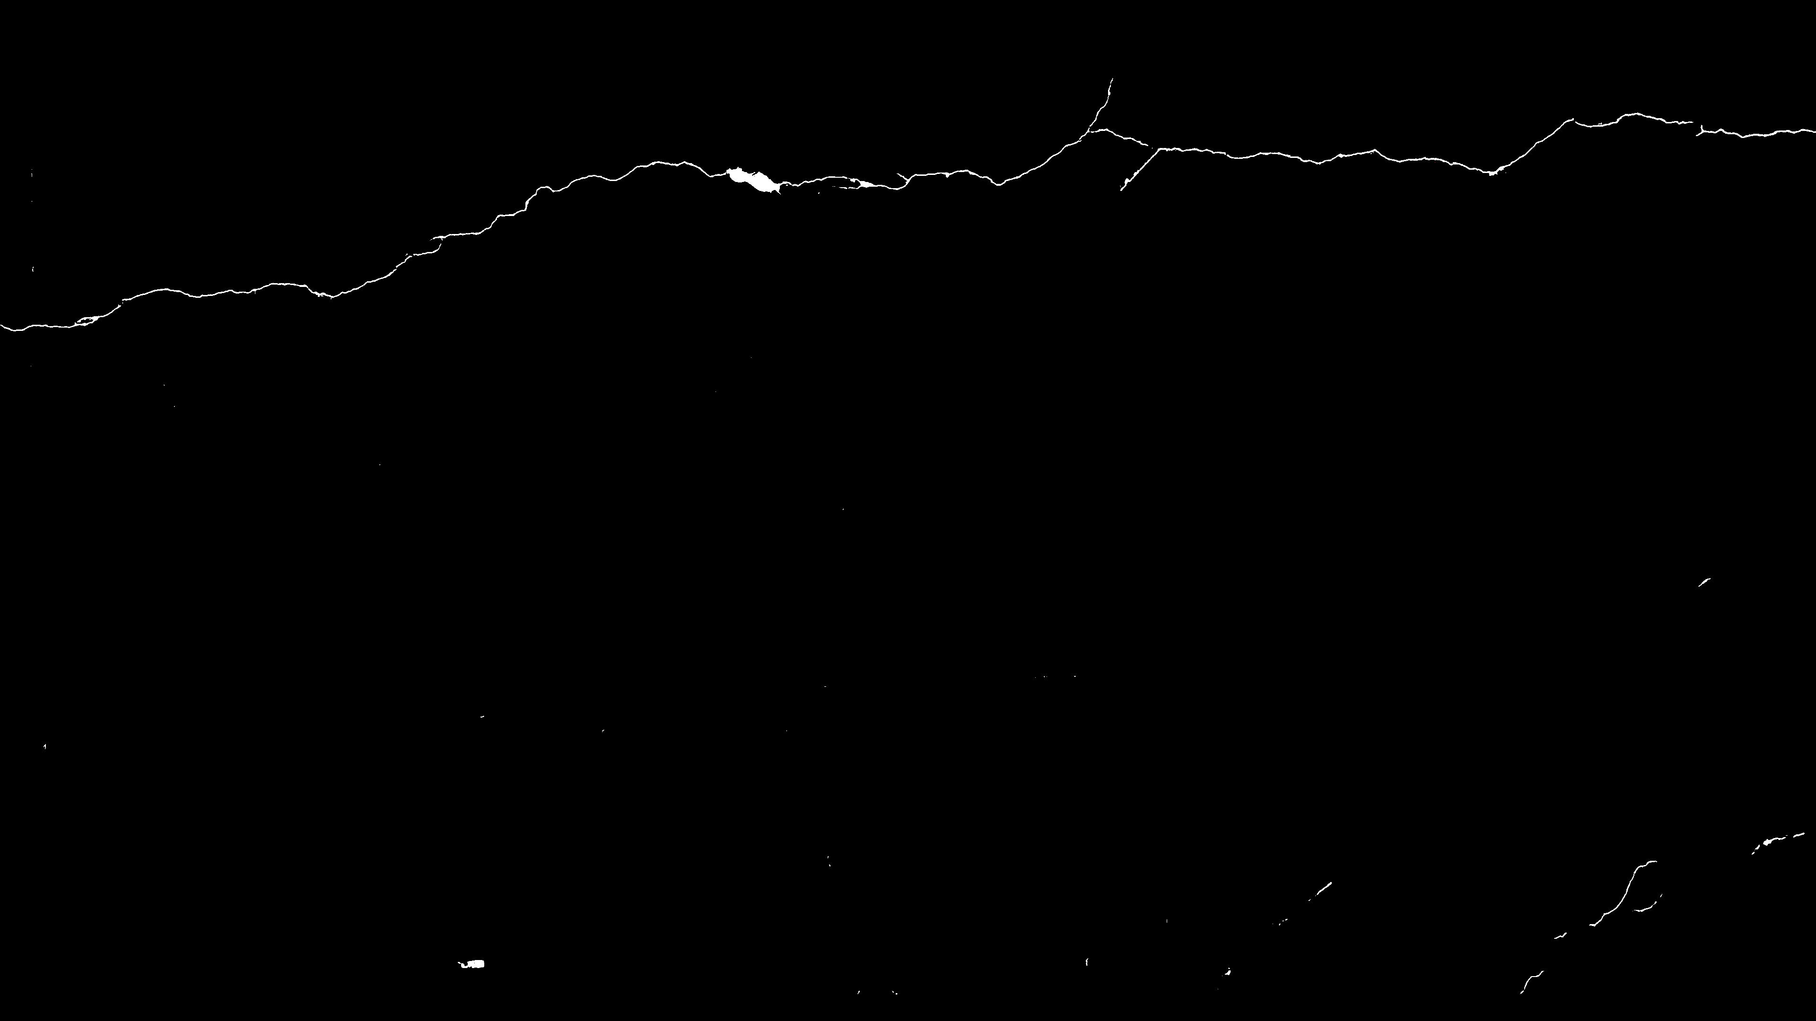
Predicted [Initialized with A]

Slide 14
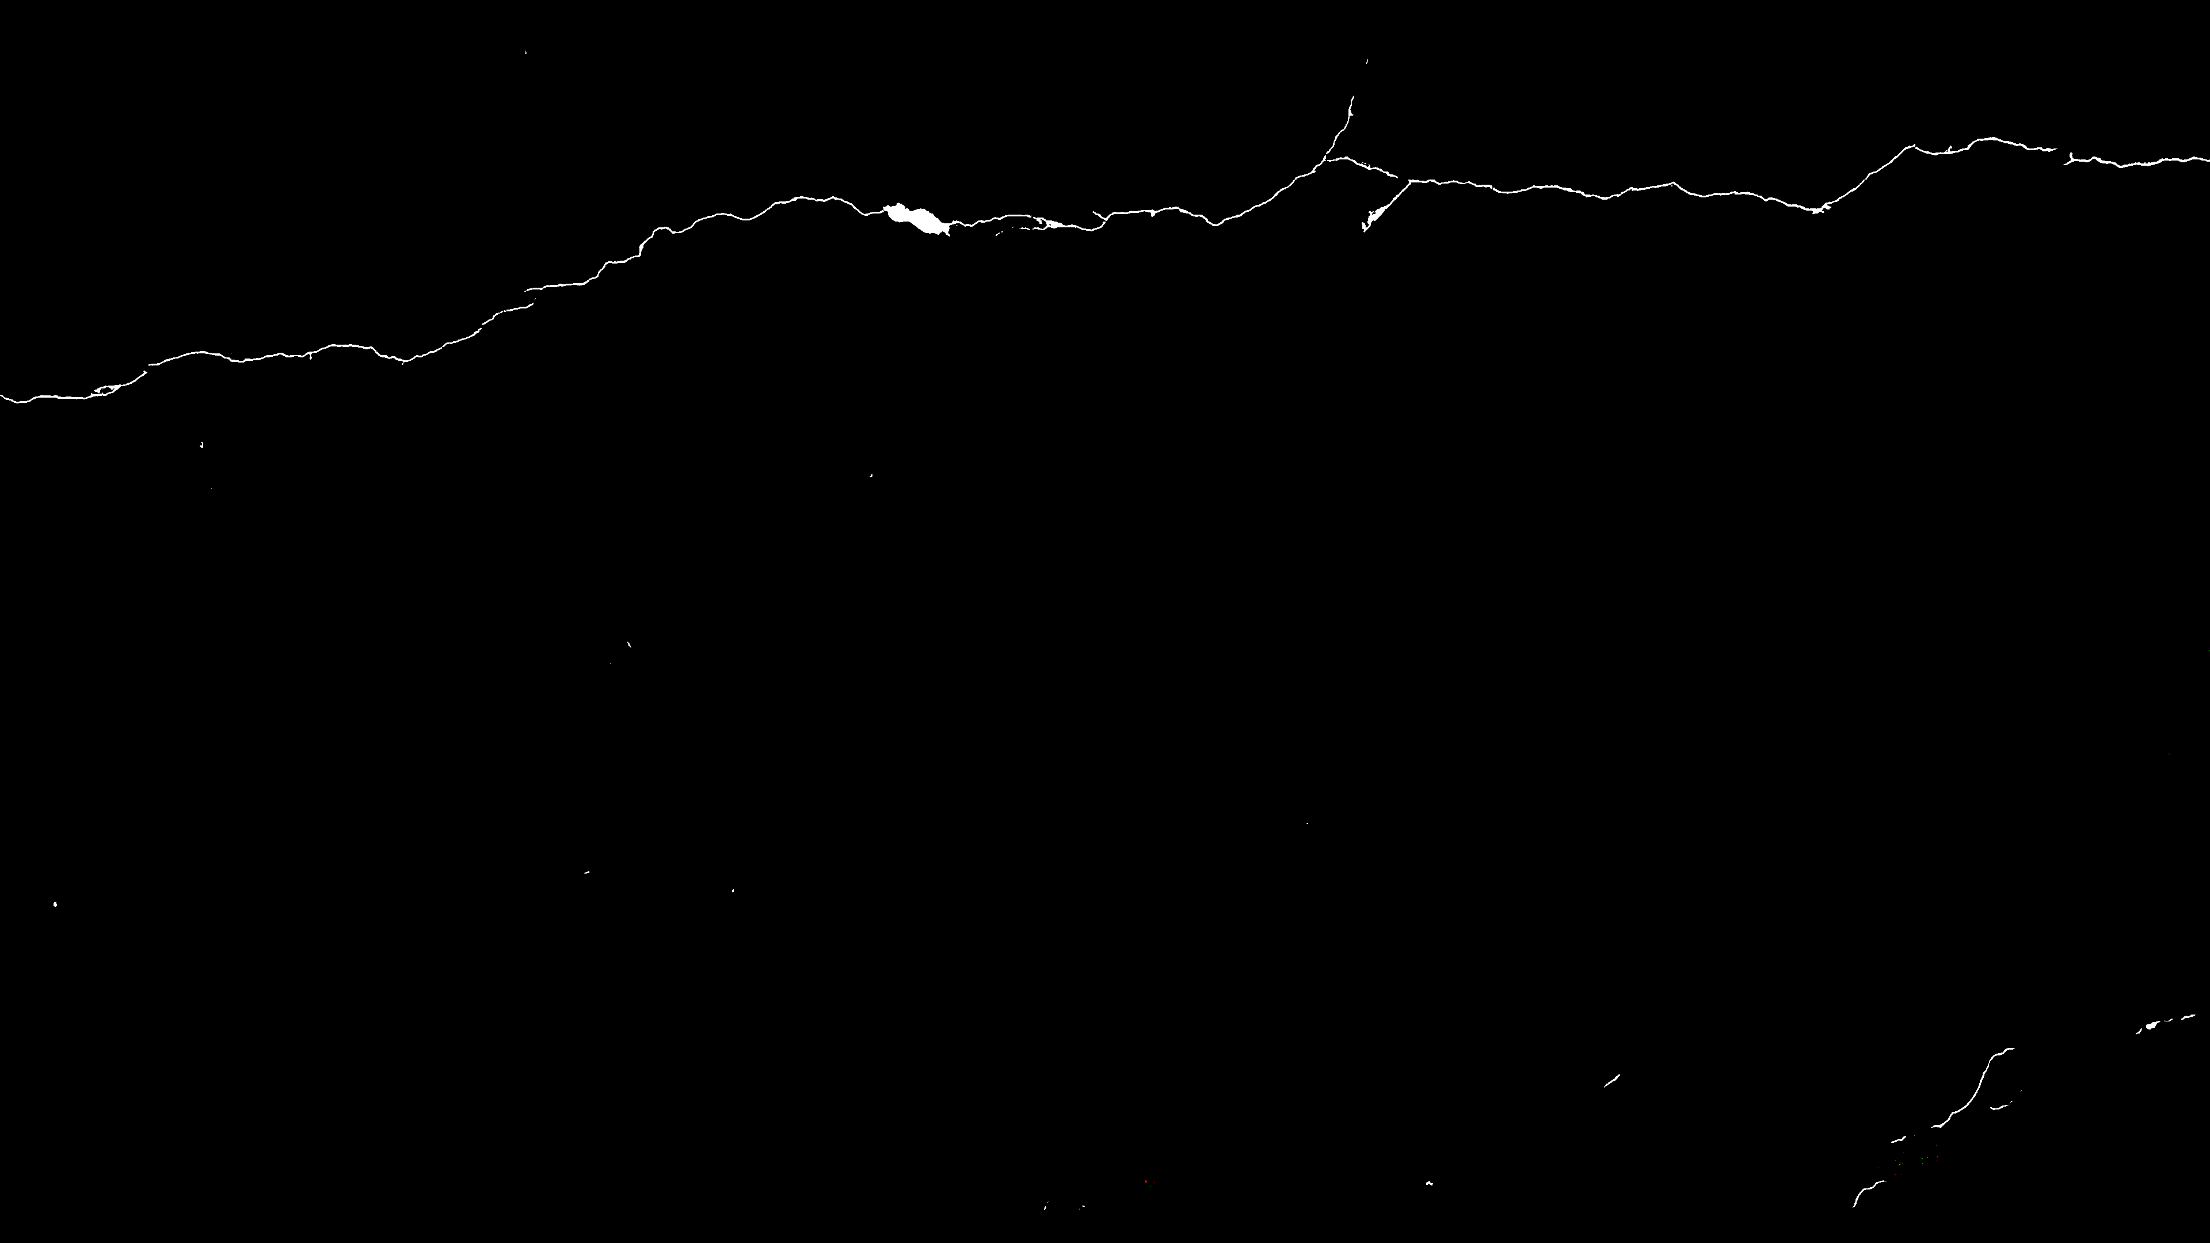
Predicted [Initialized with B]

Slide 15

Predicted [Initial weight]

Slide 16

Predicted [New weight A]

Slide 17
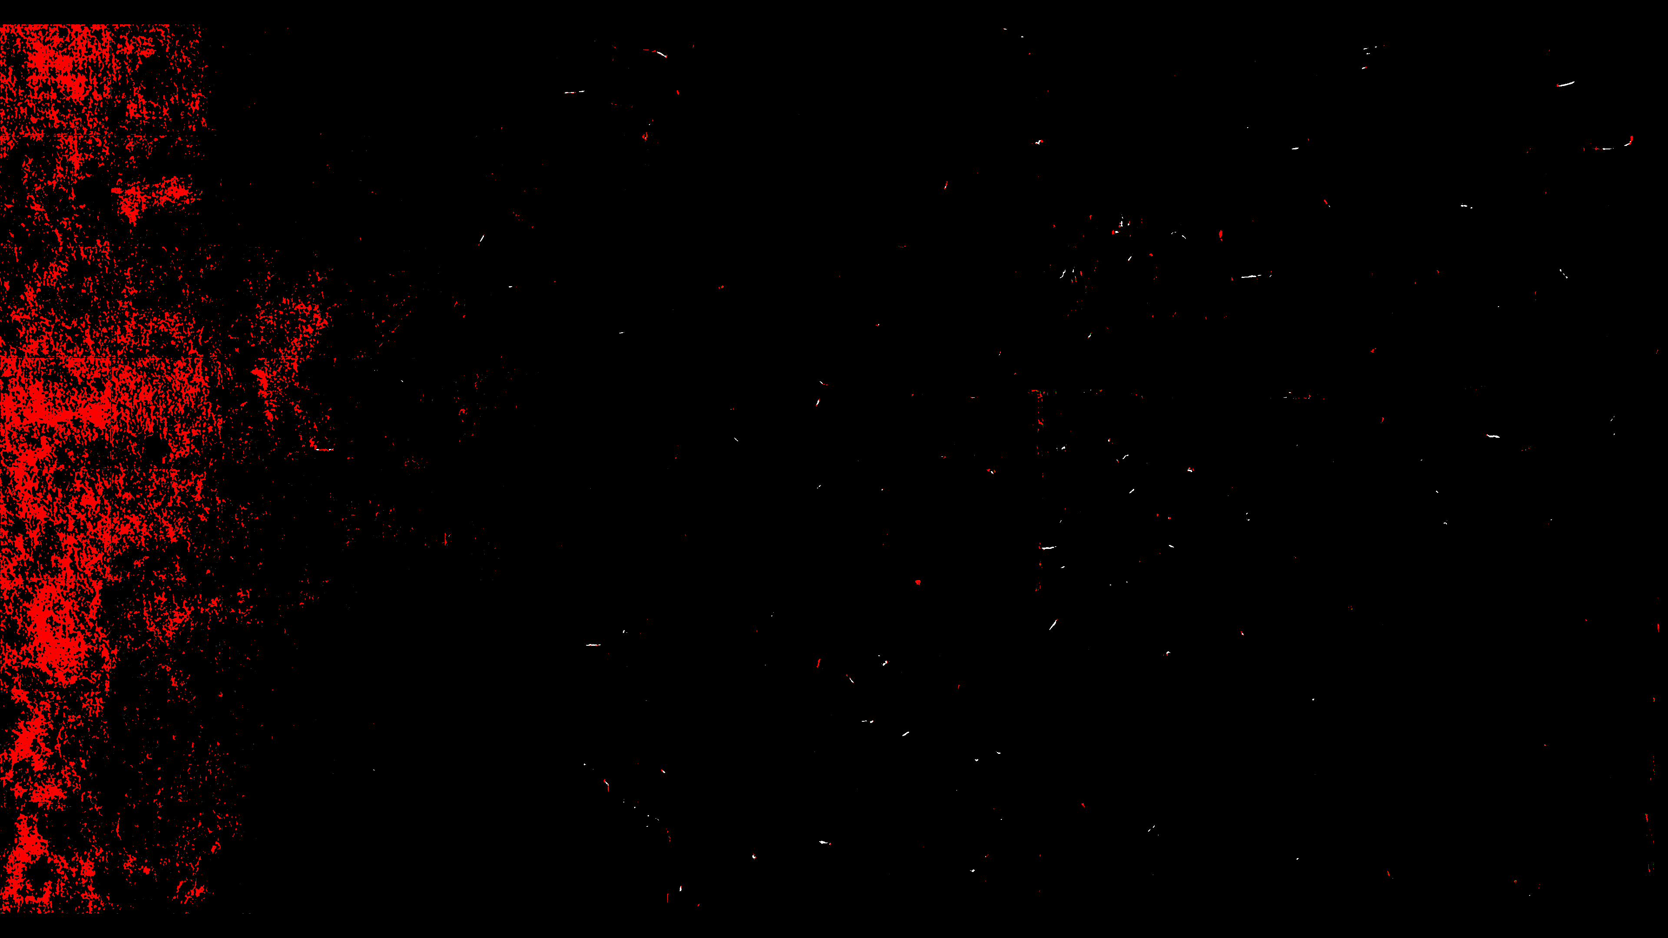
Predicted [New weight B]

Slide 18

Predicted [Initialized with A]

Slide 19

Predicted [Initialized with B]

Slide 20
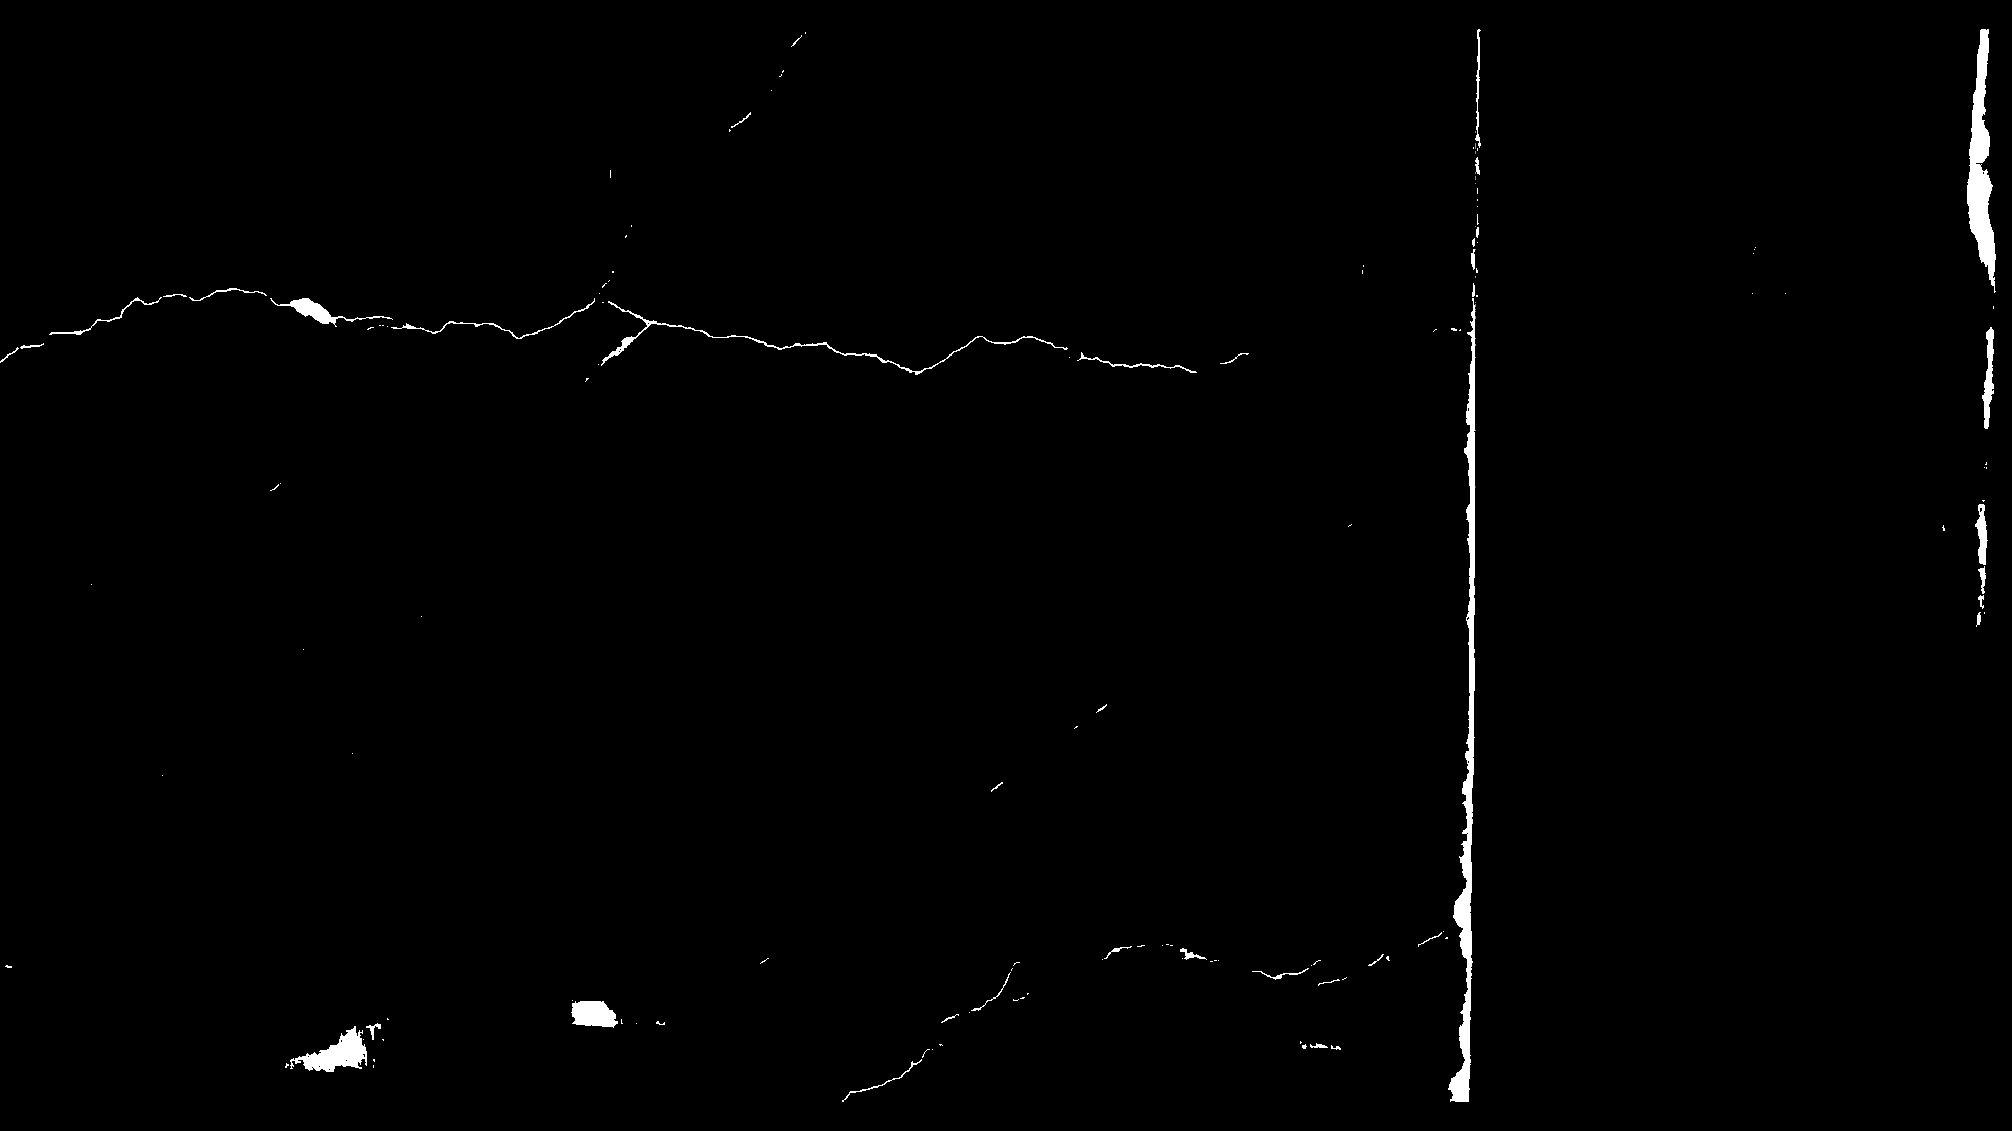
Predicted [Initial weight]

Slide 21
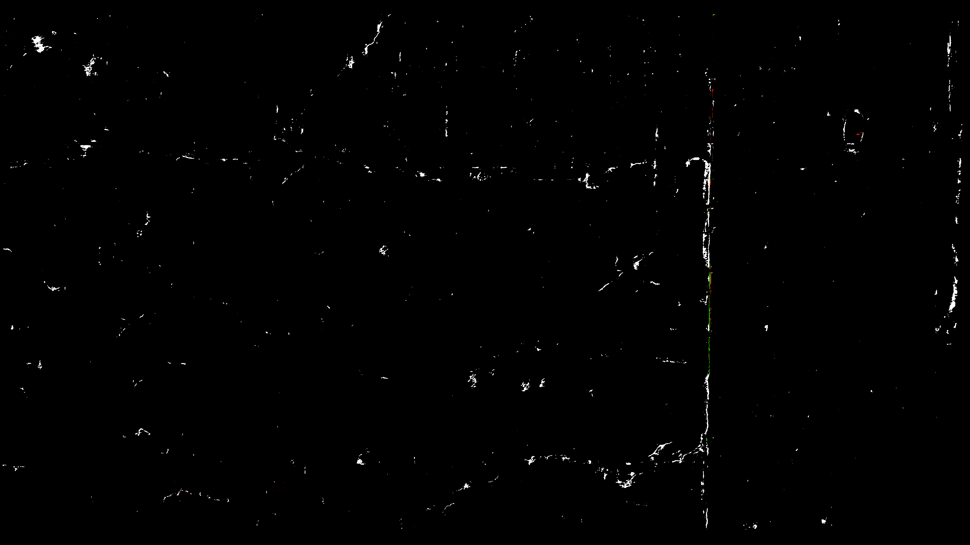
Predicted [New weight A]

Slide 22
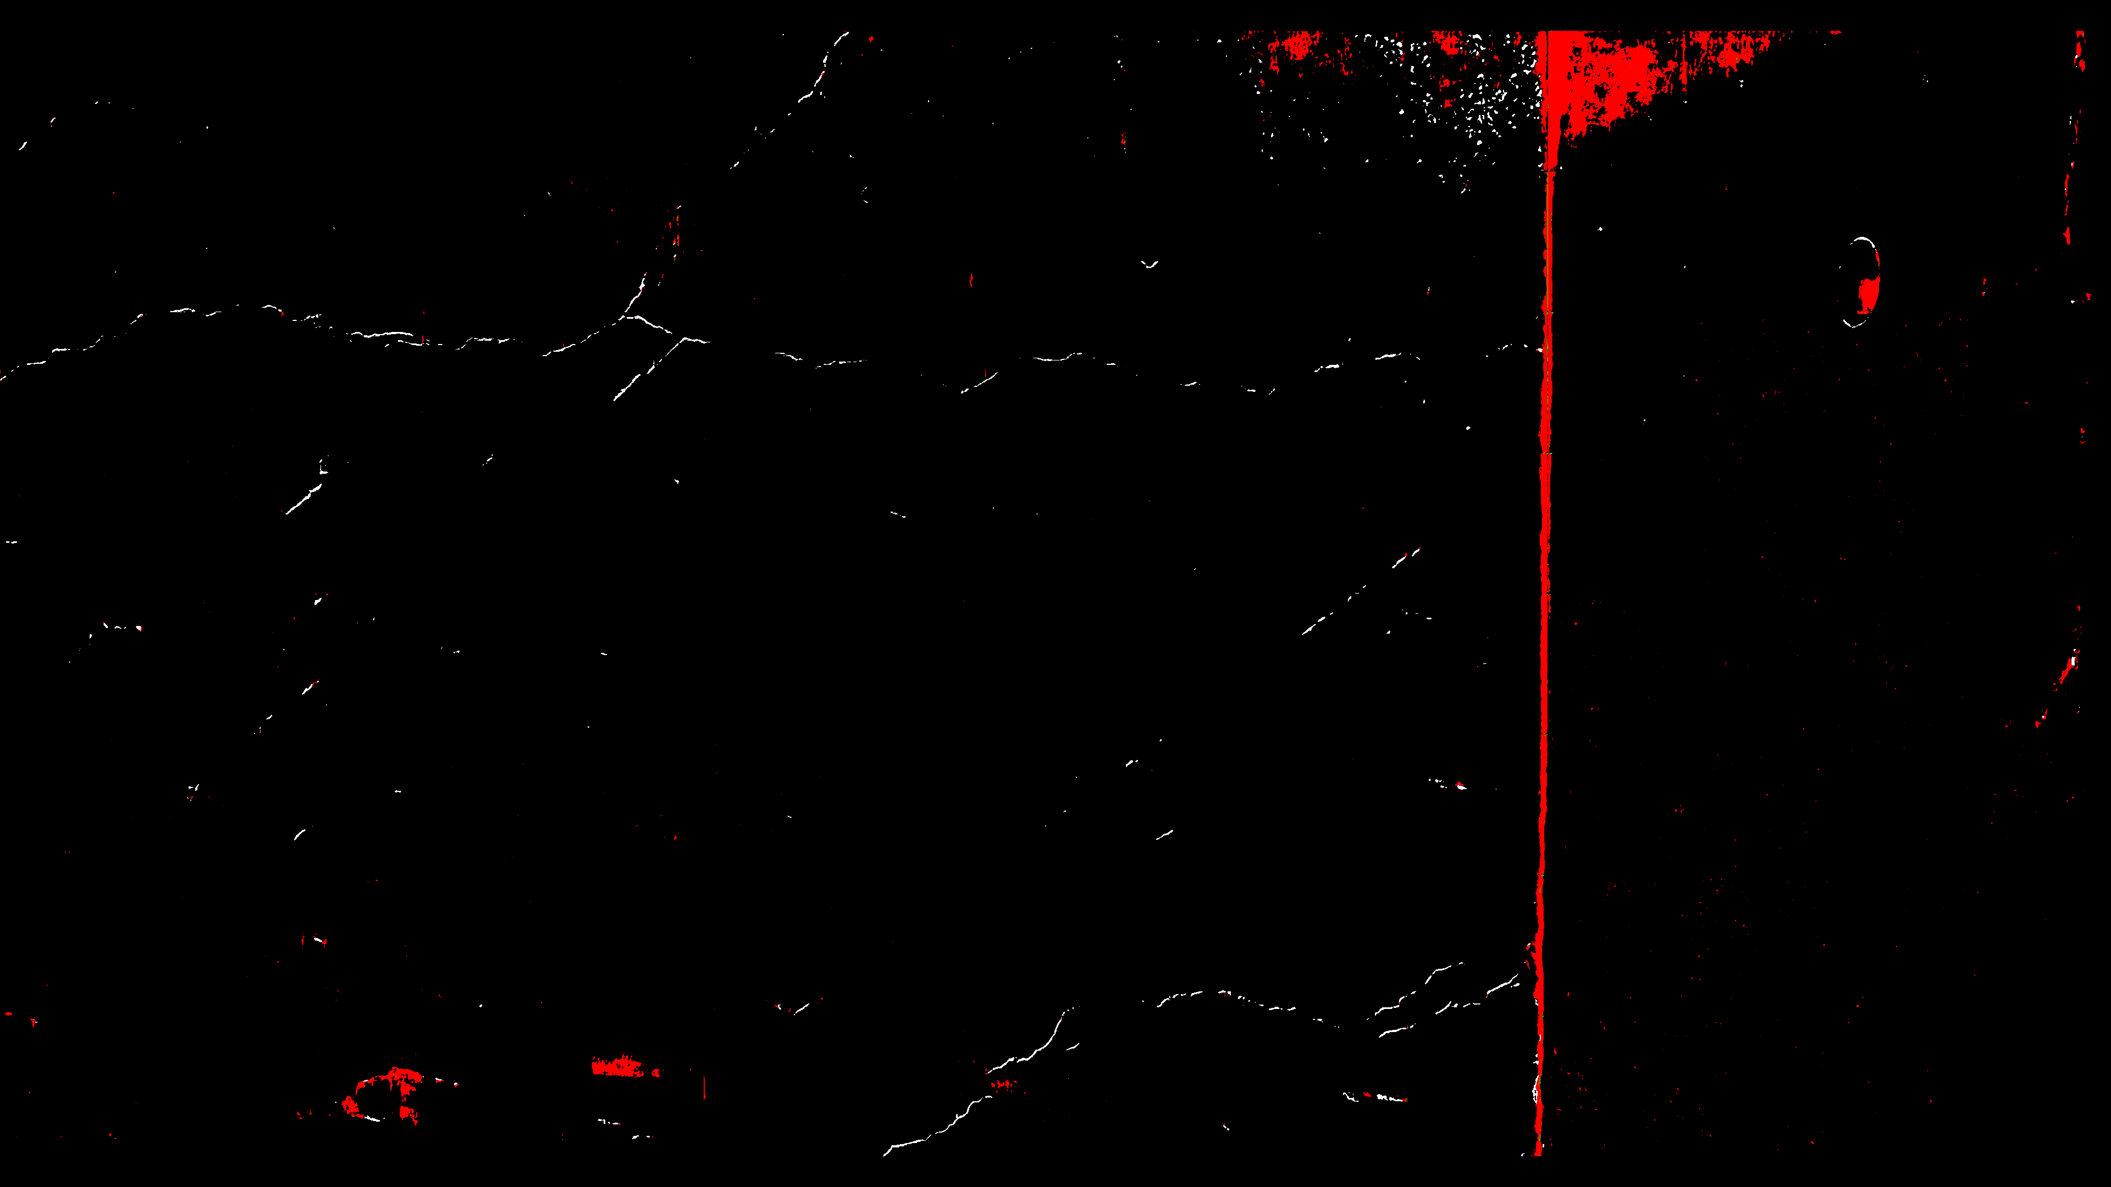
Predicted [New weight B]

Slide 23
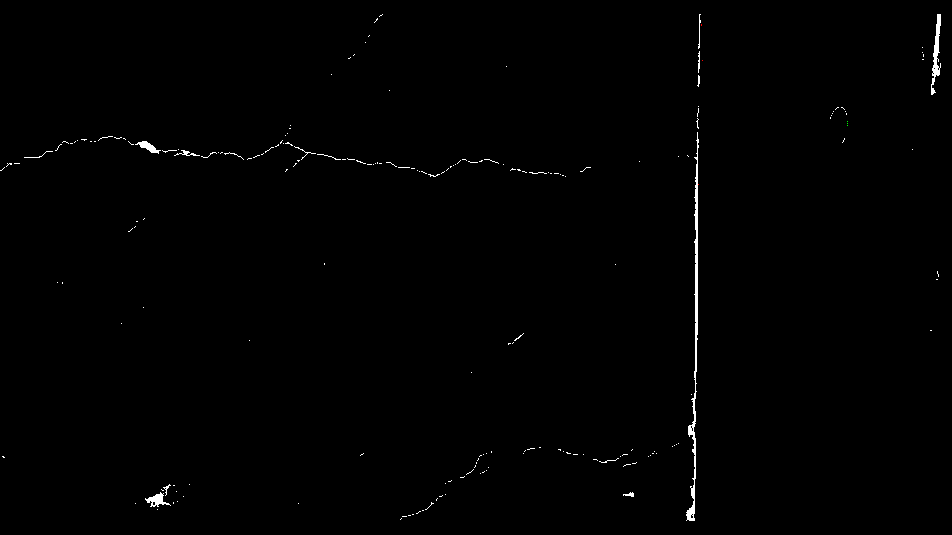
Predicted [Initialized with A]

Slide 24
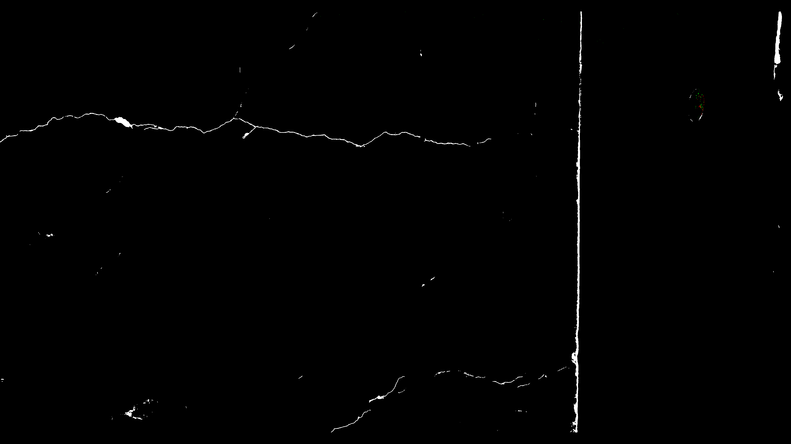
Predicted [Initialized with B]

